Slide 1

CoERS @ IIT Madras SPEED SYNC
Dr. Venkatesh Balasubramanian
Professor, RBG Labs, Dept of Engineering Design, IIT Madras
Head, Centre of Excellence for Road Safety (CoERS)
Member, Expert Advisory Group, MoRTH
Advisor, Govt of RJ, JH, HR, TN

Slide 2
WHY THIS PROJECT?

Slide 3
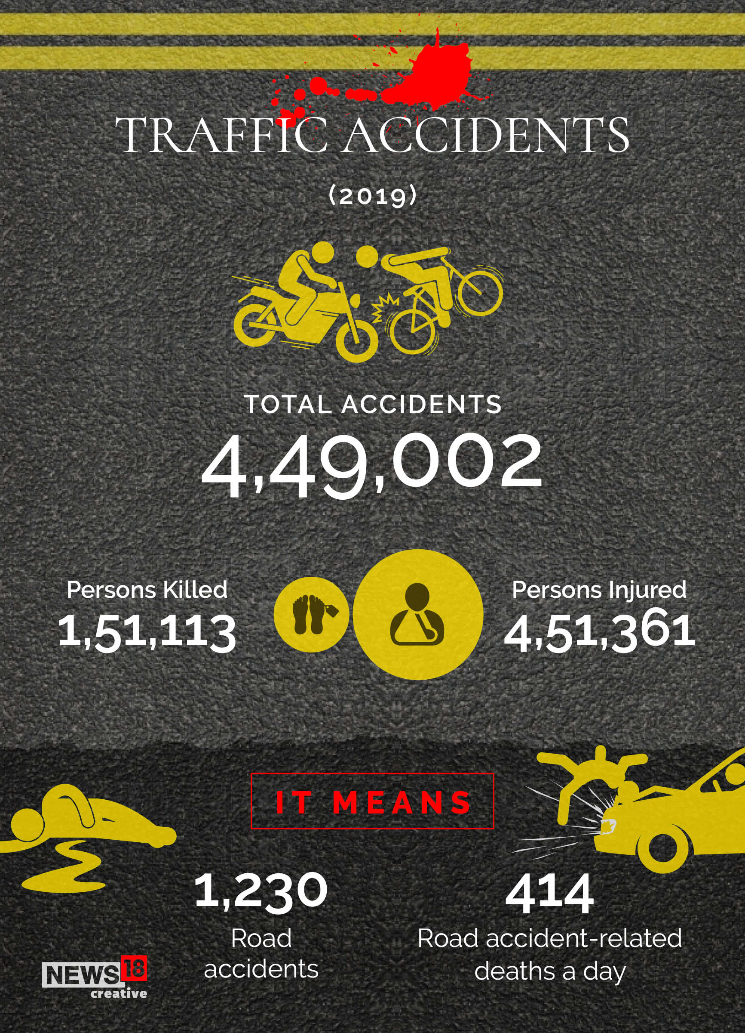
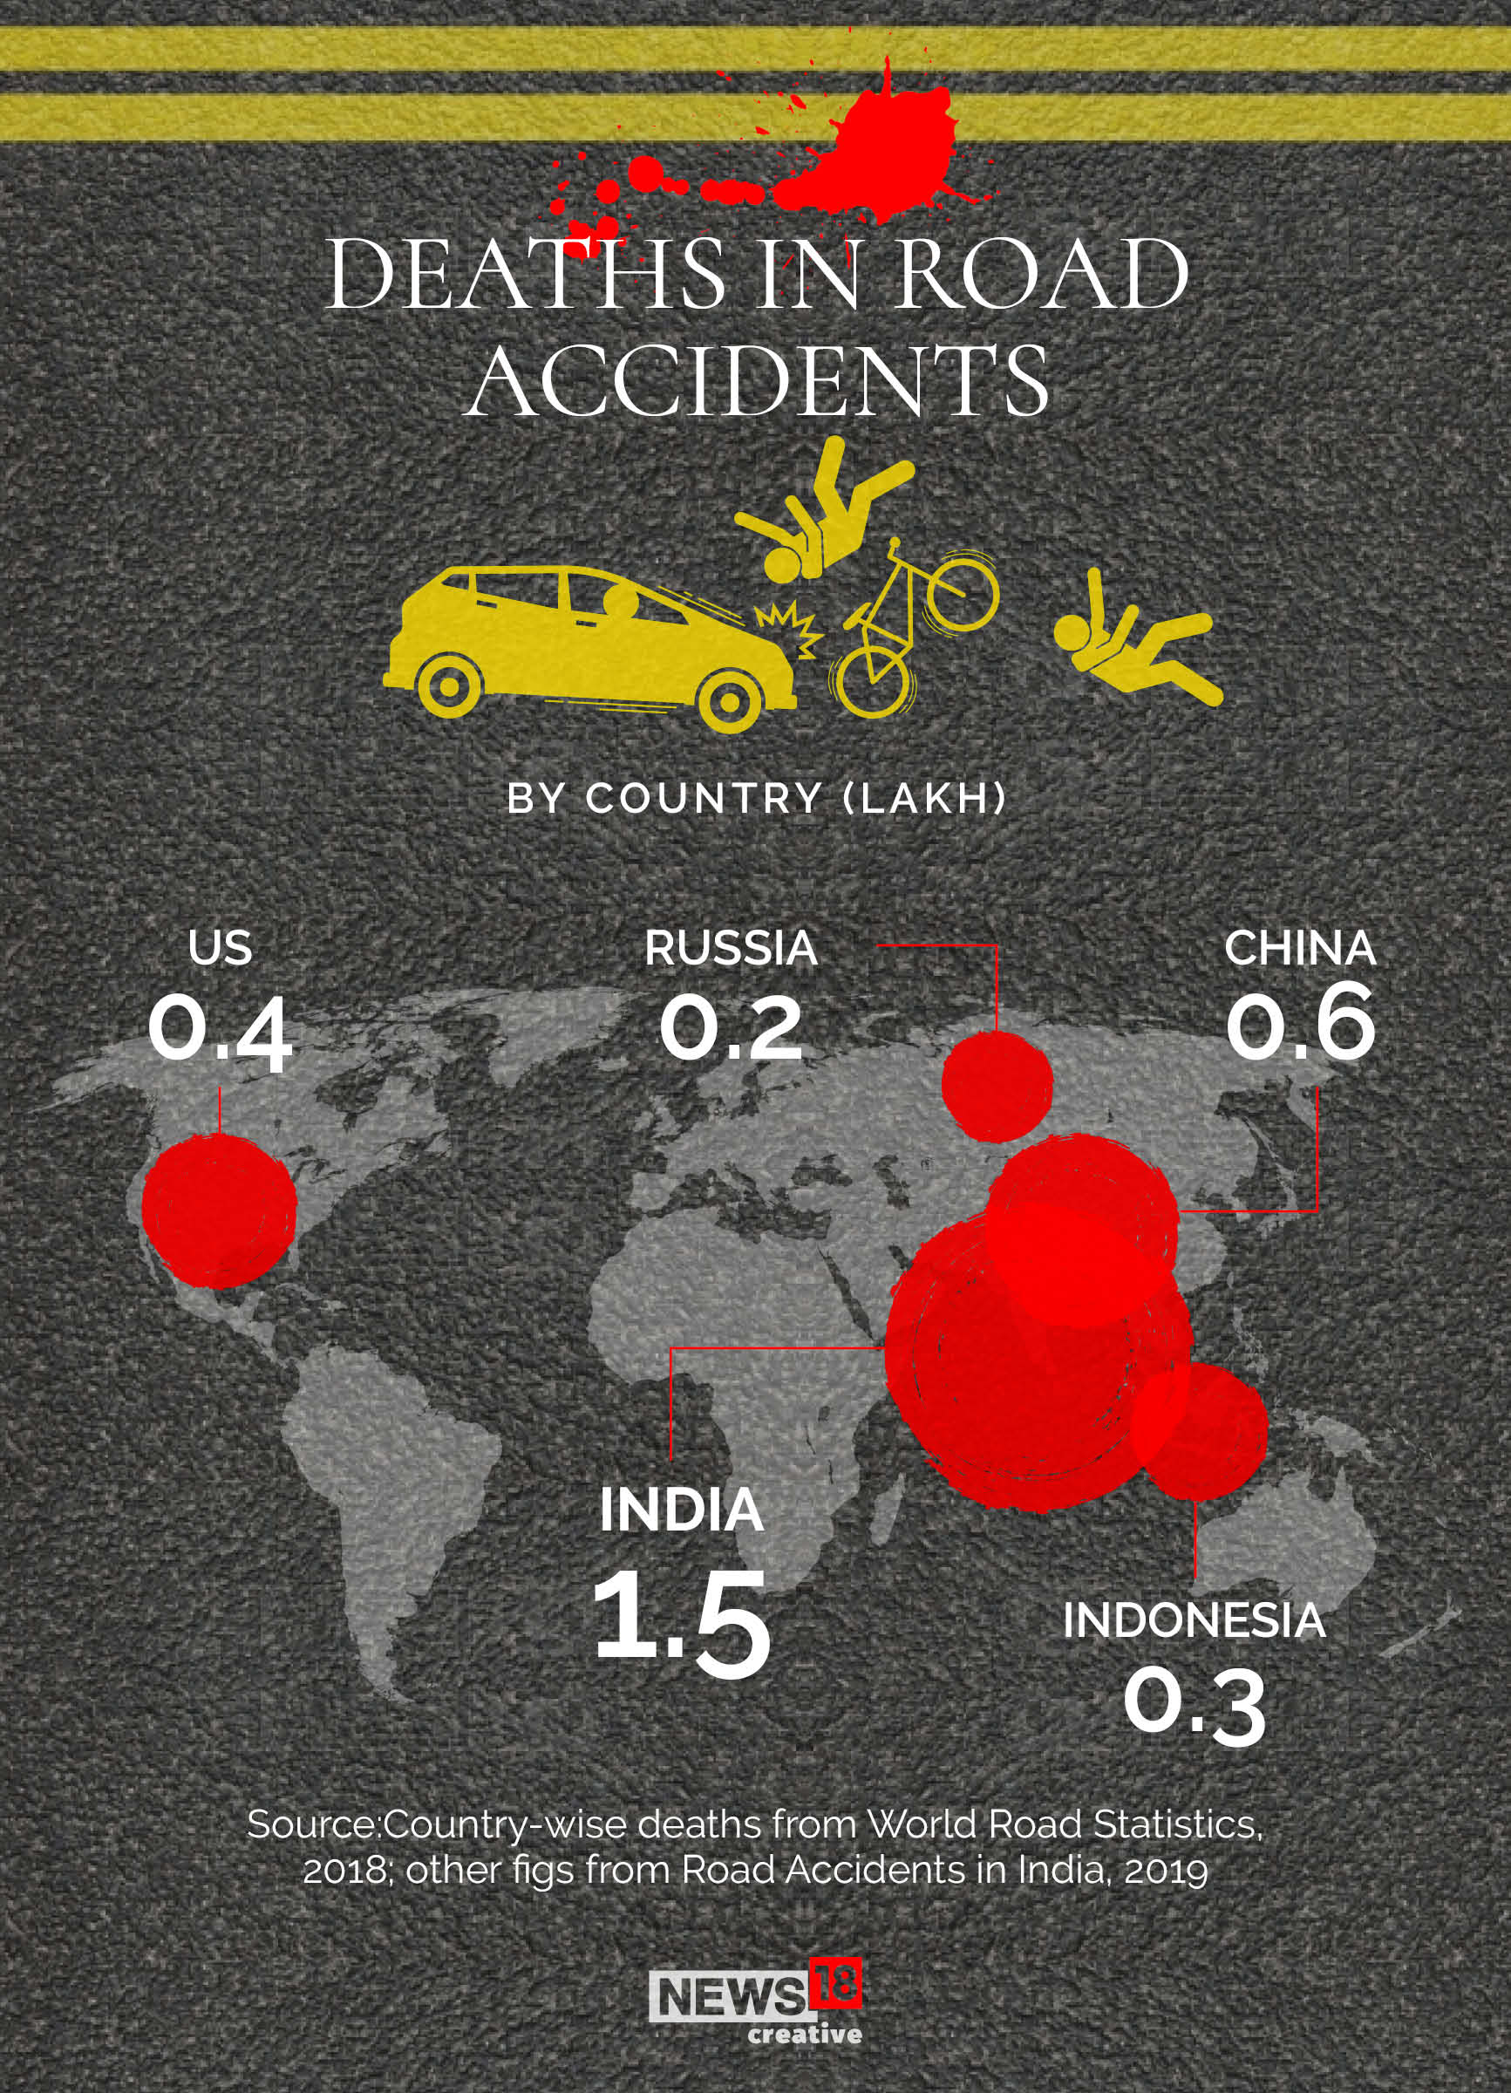
STATS
Statistics voices out on High Proportion, According to the Ministry of Road Transport and Highways (MoRTH),speeding is a major factor in a significant portion of road accidents in India. The 2022 "Road Accidents Death in India" report indicates
https://morth.nic.in/sites/default/files/RA2022_30_Oct.pdf
According to the NCRB's "Crime in India 2022" report, a total of 25,847 people died due to overspeeding in 2022
https://ncrb.gov.in/
The cause-wise analysis reveals that most of the road accidents were due to overspeeding, accounting for 2,40,828 out of 4,03,116 cases ( 59.7%) causing 87,050 deaths and injuring 2,28,274.
https://www.thehindubusinessline.com/data-stories/data-focus/overspeeding-accounts-for-60-of-the-road-accidents-in-india/article65852932.ece

Slide 4
Research @ CoERS, IIT Madras
PRIME OBJECTIVE
Dramatically reduce traffic accidents on highways and major roads by preventing overspeeding through a dynamic speed control system utilizing LoRa communication technology.

Slide 5
SPECIFIC OBJECTIVES

Slide 6
Research @ CoERS, IIT Madras
4. Data Security and Privacy:
Implement robust security measures to protect the integrity and confidentiality of speed limit data transmissions. Develop a user consent system regarding data collection and usage, adhering to relevant data privacy regulations.
Explore encryption techniques for LoRa communication to prevent unauthorized access or manipulation of speed limit data.
5. System Testing and Deployment:
Conduct comprehensive testing of the LoRa network infrastructure, OBU functionality, and overall system integration in controlled environments.
Collaborate with regulatory bodies and transportation authorities to ensure compliance with relevant safety standards.
Implement a phased deployment strategy, starting with pilot programs on select highways and gradually expanding based on success metrics.
6. Public Awareness and Education:
Launch public awareness campaigns to educate drivers about the dynamic speed control system and its benefits for road safety.
Collaborate with driving schools and educational institutions to integrate information about the system into driver training programs.
Encourage responsible driving behavior by highlighting the positive impact of adhering to posted speed limits
1.LoRa Network Infrastructure:
Develop a network of LoRa transmitters strategically positioned alongside speed limit signs on highways and major roads.
Ensure sufficient transmitter density to provide reliable LoRa signal coverage throughout the target roadways.
Explore mechanisms for signal redundancy in case of potential obstacles or interference.
2. Vehicle Onboard Unit (OBU) Development:
Design and develop an in-vehicle OBU that receives real-time speed limit data transmitted via LoRa from roadside units.
Integrate the OBU with the vehicle's existing speed limiter system or develop a standalone speed control mechanism.
Prioritize user safety by incorporating fail-safe mechanisms in case of communication disruptions or system malfunctions.
3. Automatic Speed Limit Adjustment:
Program the OBU to automatically adjust the vehicle's speed limiter based on the received speed limit data. Implement a user-configurable buffer zone around the received speed limit to account for potential signal delays or driver reaction times.
Design the system to allow for manual speed overrides in emergency situations with clear warnings and potential logging for accountability.

Slide 7
HOW WILL YOU DO? -BILL OF MATERIALS -TOOLS REQUIRED -METHODOLOGY

Slide 8
Summary of RBG Labs Activities
COMPONENTS | QUANTITY | PRICE
RFM95W (LoRa) | 2 | 1378
Arduino Nano | 2 | 548
MCP2515 CAN Bus | 1 | 299
9v Battery | 2 | 50
Solar Panel (optional) | 1 | 450
Electronic Speed Limiter(Optional) | 1 | 2999
SOFTWARE TOOLS REQUIRED
Integrated Development Environment
(Arduino IDE, Visual Studio Code)
Communication Protocol Library
(LoRa and CAN communication )
Simulation and Testing Software
TOTAL
Rs. 2275/-

Slide 9
WHERE WILL THE WORK TO BE DONE?

Slide 10
Areas with High speed Traffic and overspeeding incidents
Roads with Varying speed Limits
Temporary speed Limits due to roadwork and construction activities
Areas with reduced speed limits
Curved or Hilly Roads, where speed control is crucial
Areas with high Pedestrian Activity

Slide 11
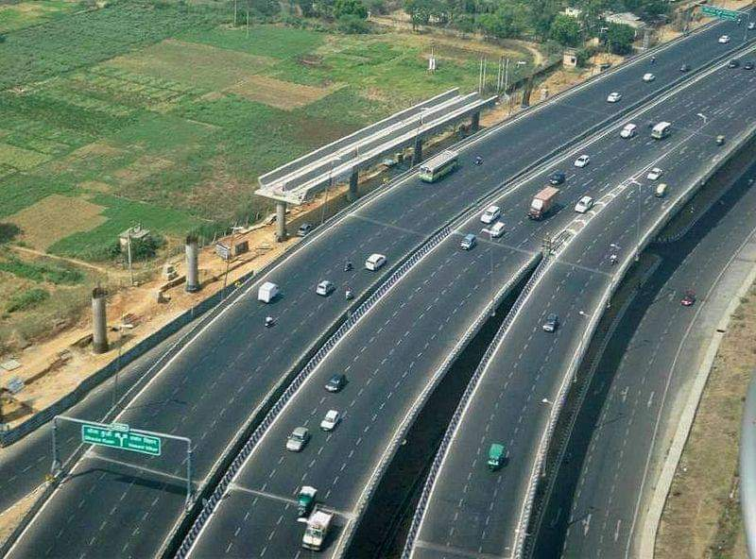
WHERE WILL THE WORK BE DONE?
LOCATION : Highways and major roadways
SPEED SYNC aims to achieve real-time compliance with speed limits, reduce traffic accidents, and create safer driving environments on highways and major roadways.
The successful implementation and testing of this system could pave the way for widespread adoption and set a new standard in smart traffic management solutions globally.

Slide 12
METHODOLOGY

Slide 13
Scan limit sign board (with LoRa Transceiver)
Transmit speed limit data
Vehicle with LoRa Receiver
Receive speed limit data
microcontroller
Process speed limit data
CAN bus data
Communicate with speed limiter
Adjust Vehicle speed

Slide 14

Welcome @
http://www.ed.iitm.ac.in/~vb
vb@smail.iitm.ac.in
rbg@imail.iitm.ac.in

Slide 15

Thank You !!!

